Slide 1
StockView
nicholas Bohay
Capstone Project
5-3-2017

Slide 2
Importance
People are looking for ways to make more money
Retiring
Banks interest rates poor
Computers are taking over Stock Markets
Used to buy/sell stock and predictions
Cause overly hyped stocks to go up
Interested in Business and Data

Slide 3
Implementation
Python (data)
HTML/CSS/PHP (user input)
JavaScript/JQuery (Predictive Text/Calendar)

Slide 4
Obstacles
Python to HTML instead of Python shell
Needed to learn CGI (Common Gateway Interface)
TIME

Slide 5
Evaluation
Calculations are slow
More scalable as an AI application,
Keep up to date with latest advances in technology
Certain functions are reusable
Provides information on stock
Many factors affect prices

Slide 6
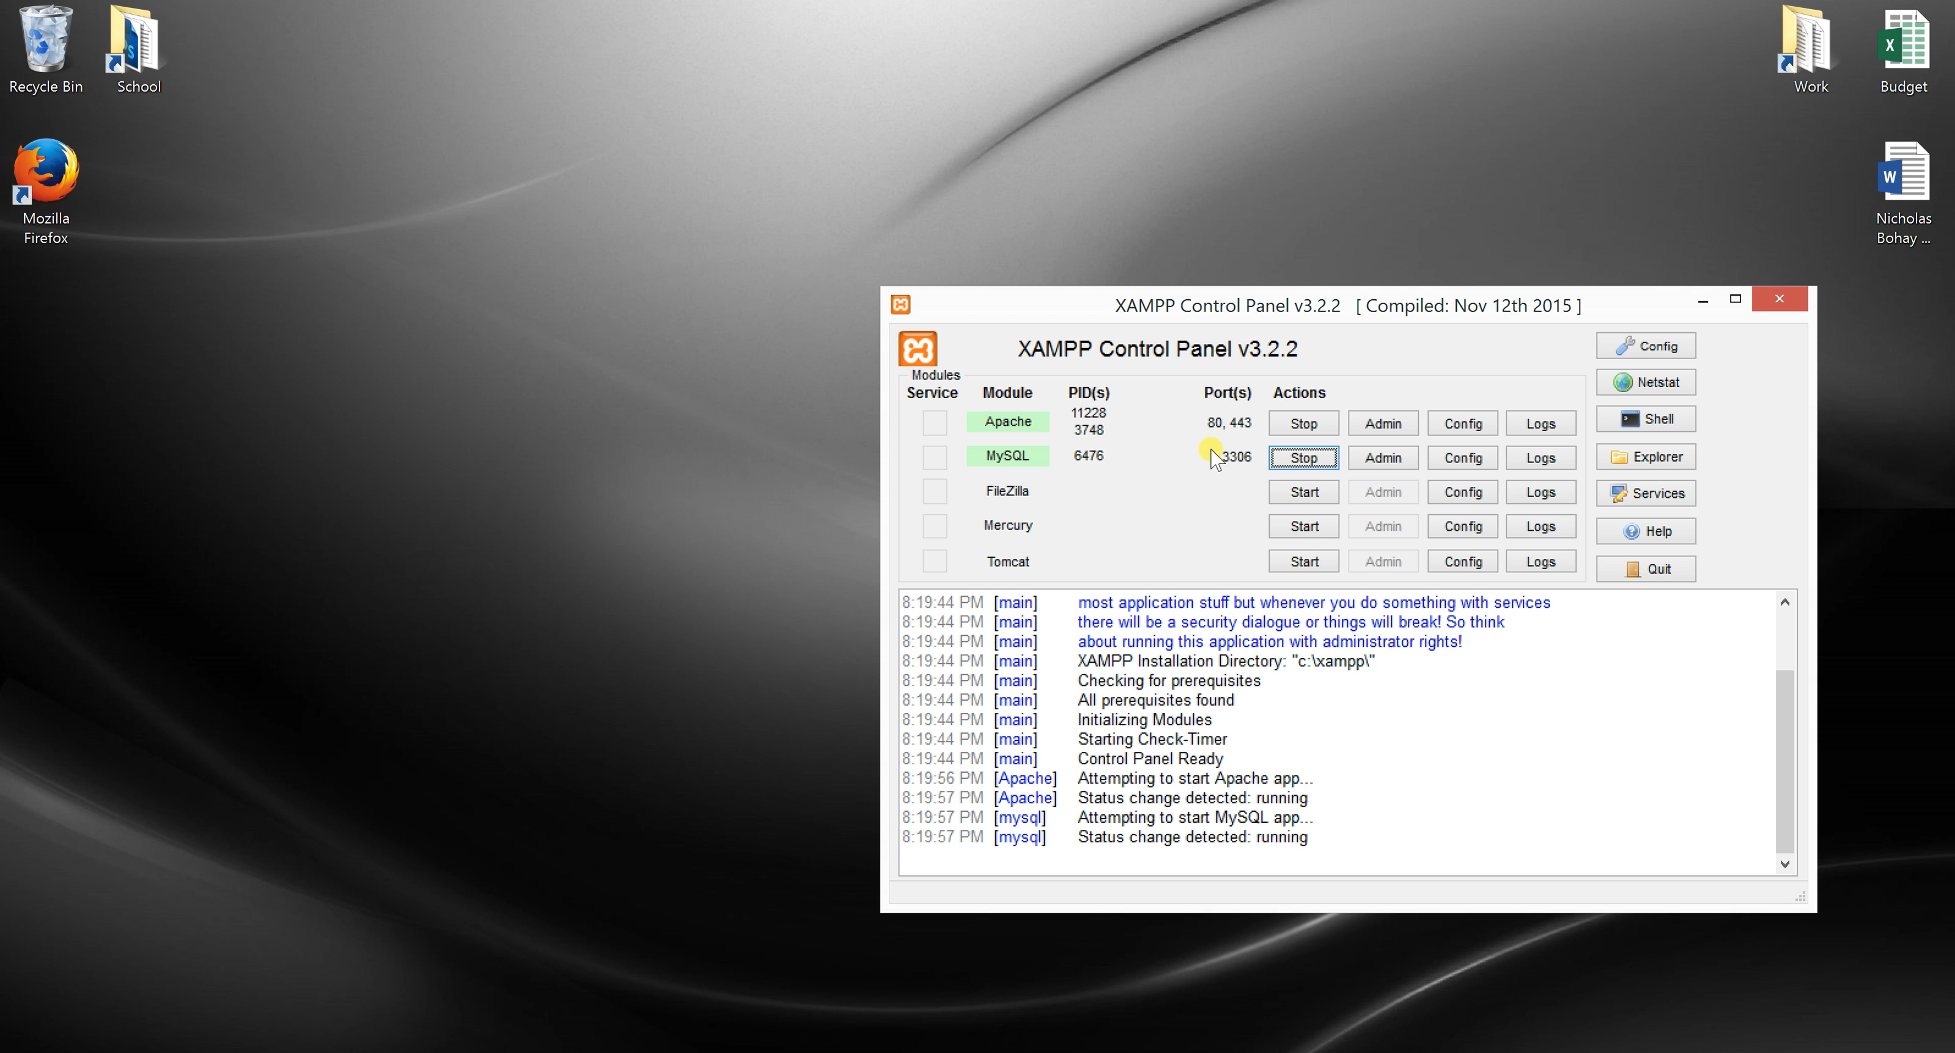

Slide 7
Future Vision
Speed up program
Use more statistics for futures with graphs
Use AI python libraries
Find another source for the news
Add more than just NYSE

Slide 8
Thank You!

